Slide 1
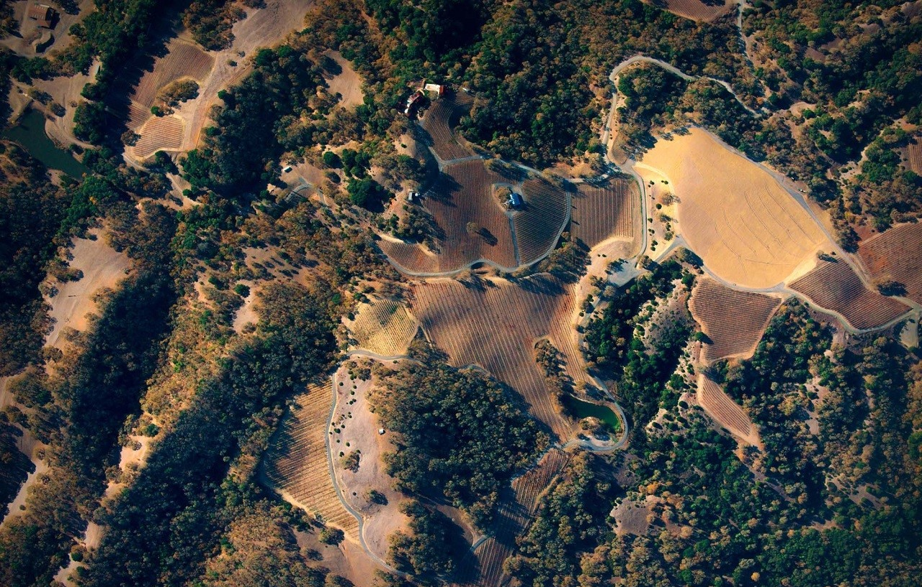

Carise Fernandez
Software Engineer, TerrAvion
Notes:
Hi. I’m Carise, and I’m a software engineer at TerrAvion. I’ll be talking a little more about what I do, as well as what TerrAvion does, over the next hour.
TerrAvion is a subscription aerial imagery service for agriculture.

Slide 2
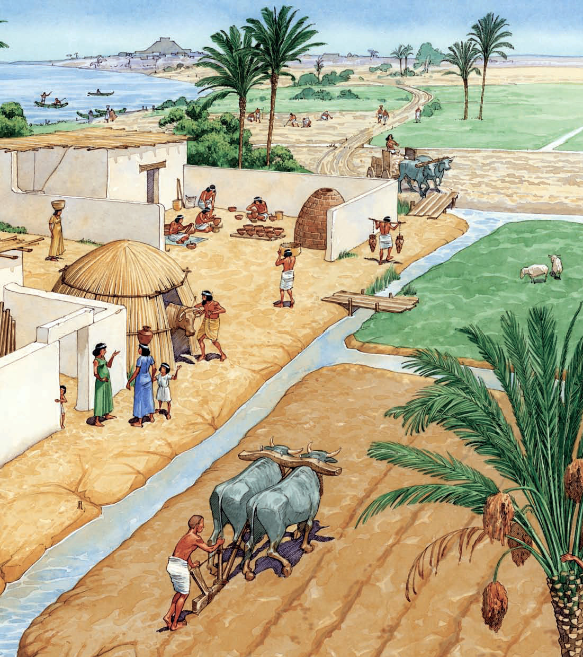
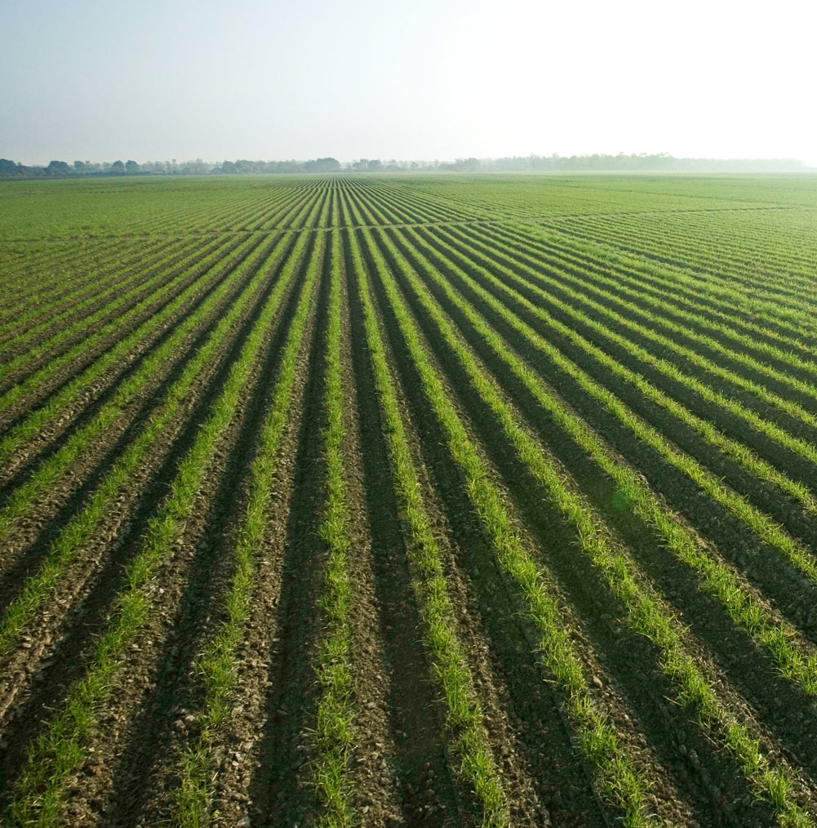
Agriculture: Then and Now
Notes:
Now, let’s talk about agriculture. What comes to mind when you think about agriculture? <take volunteers>
Food
The California drought
World hunger
Farm stuff
Since early civilizations, agriculture has been an important aspect of society. Not only were these nations able to sustain themselves by growing food but also they were able to facilitate jobs and trade, among other things. Agriculture has seen much development in terms of methods and technology throughout the centuries. Today, we have a lot of machinery and technology that reduces the amount of manual labor that used to be associated with agriculture.
While agriculture may not be directly part of people’s lives nowadays, its importance remains the same. The world’s population is over 7 billion and according to worldhunger.org, the world DOES produce enough food to feed everyone! Except that not everyone can afford it. World hunger is thus an unfortunate reality.
Well, how hard can it really be to produce affordable food? Let’s first talk about some facts.

Slide 3
Issues in Ag
Land availability
Supply and demand of crops
Financial markets
Government policy and regulation
Sustainability of ag production
Natural disasters (including global warming)
Notes:
In 2011, CaseIH (an agriculture equipment and services company) issued a survey to farmers in order to understand the farmers’ needs and how to address them better. The survey results listed some common (and high ranking) issues:
Land availability
Supply and demand of crops
Impact of the financial markets
Government policy and regulation
While not mentioned in the survey, other common issues that farmers face include
Sustainability of ag production (e.g. how ag affects the environment both now and down the road)
Natural disasters (including global warming)
With all of these issues that farmers have to face, no wonder food production costs are not lower!

Slide 4
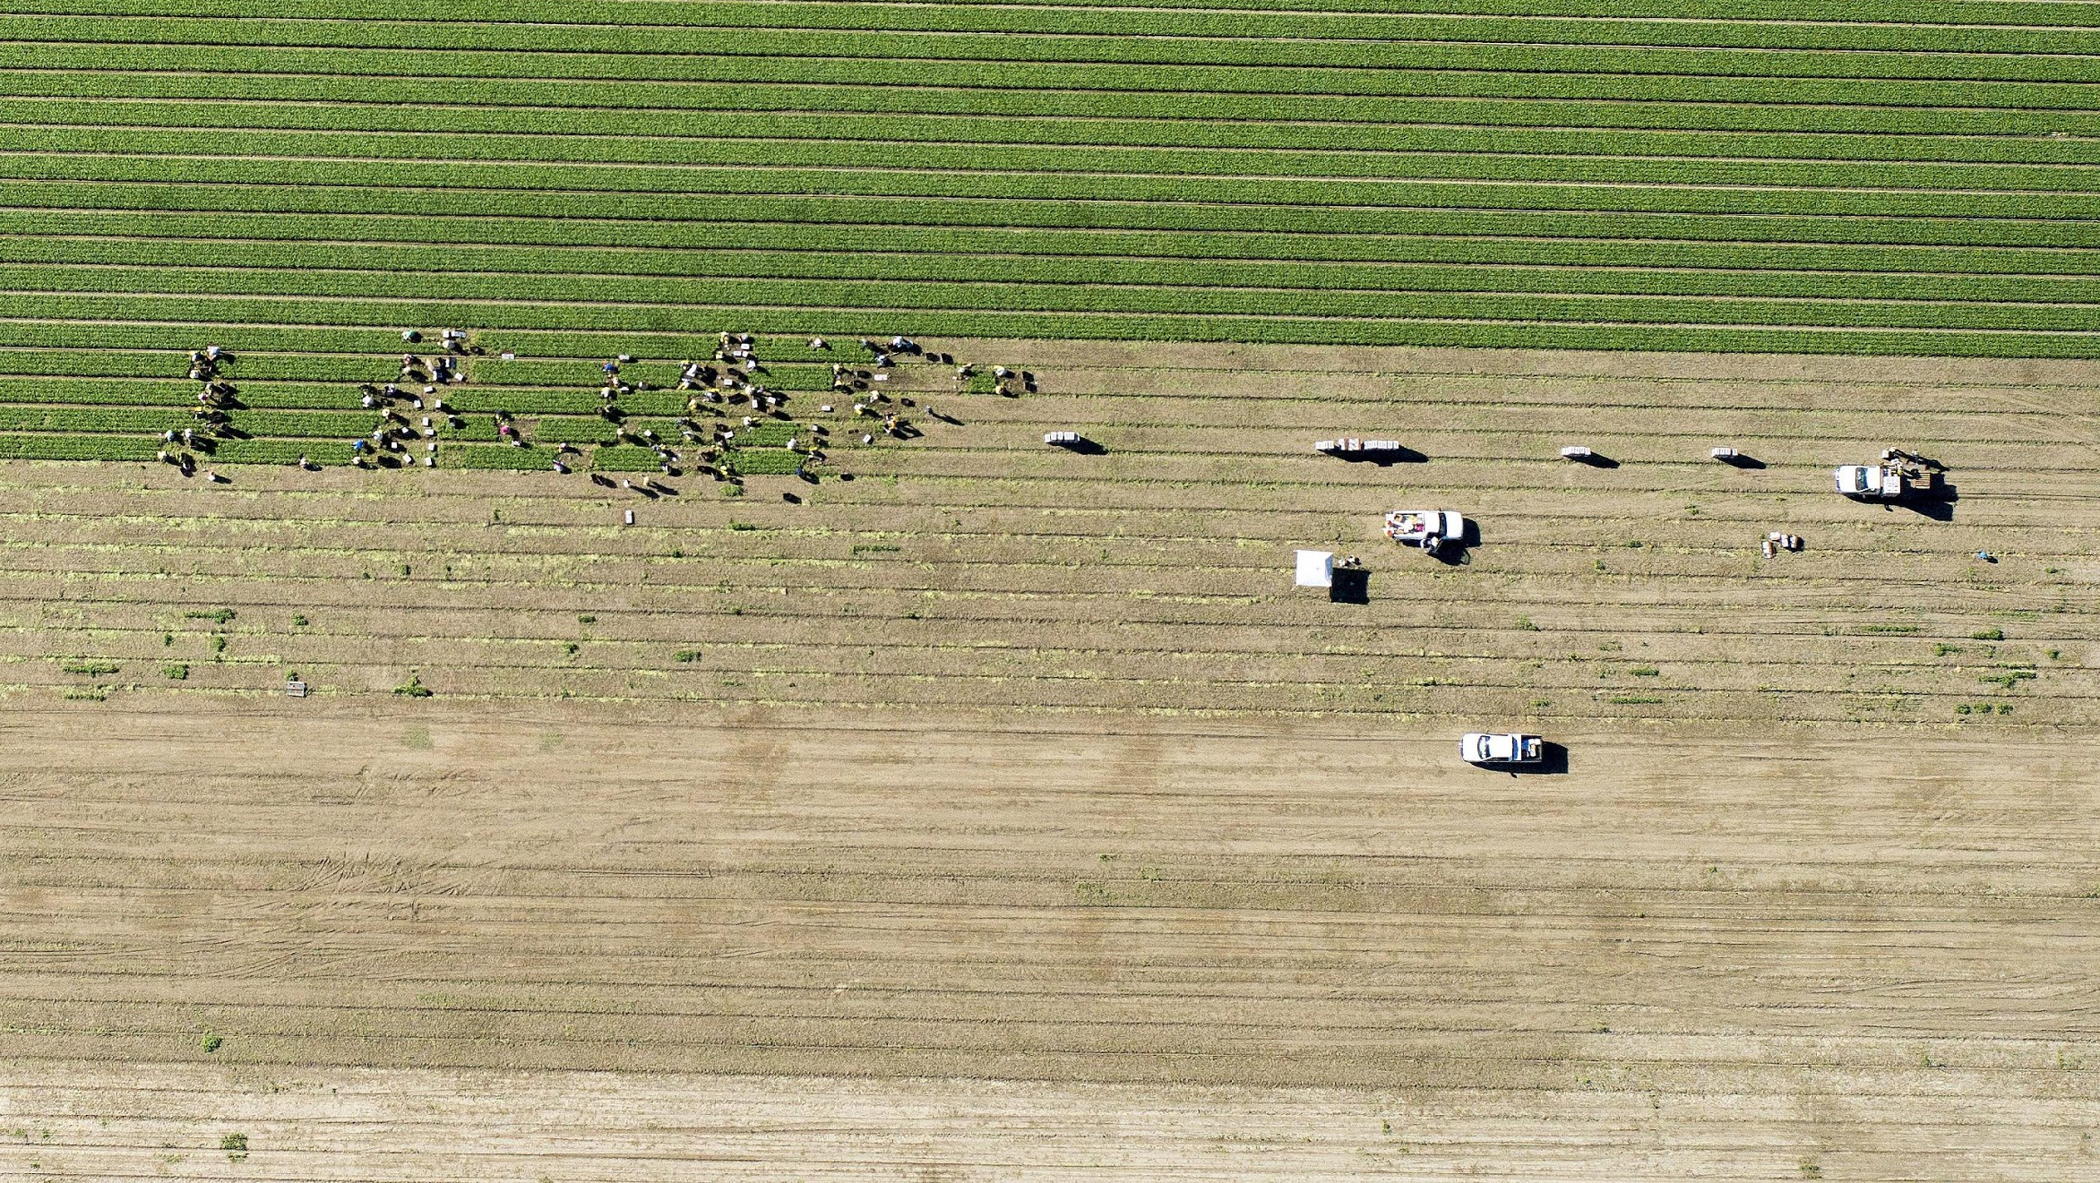
Notes:
Well, it’s pretty clear what the problems are. So let’s talk about solutions.
Enter TerrAvion.
Every week, we fly over farms who subscribe to our service, and we capture images of the fields in different wavelengths. The images get uploaded and processed, and then the farmers use our imagery to optimize their work.

Slide 5
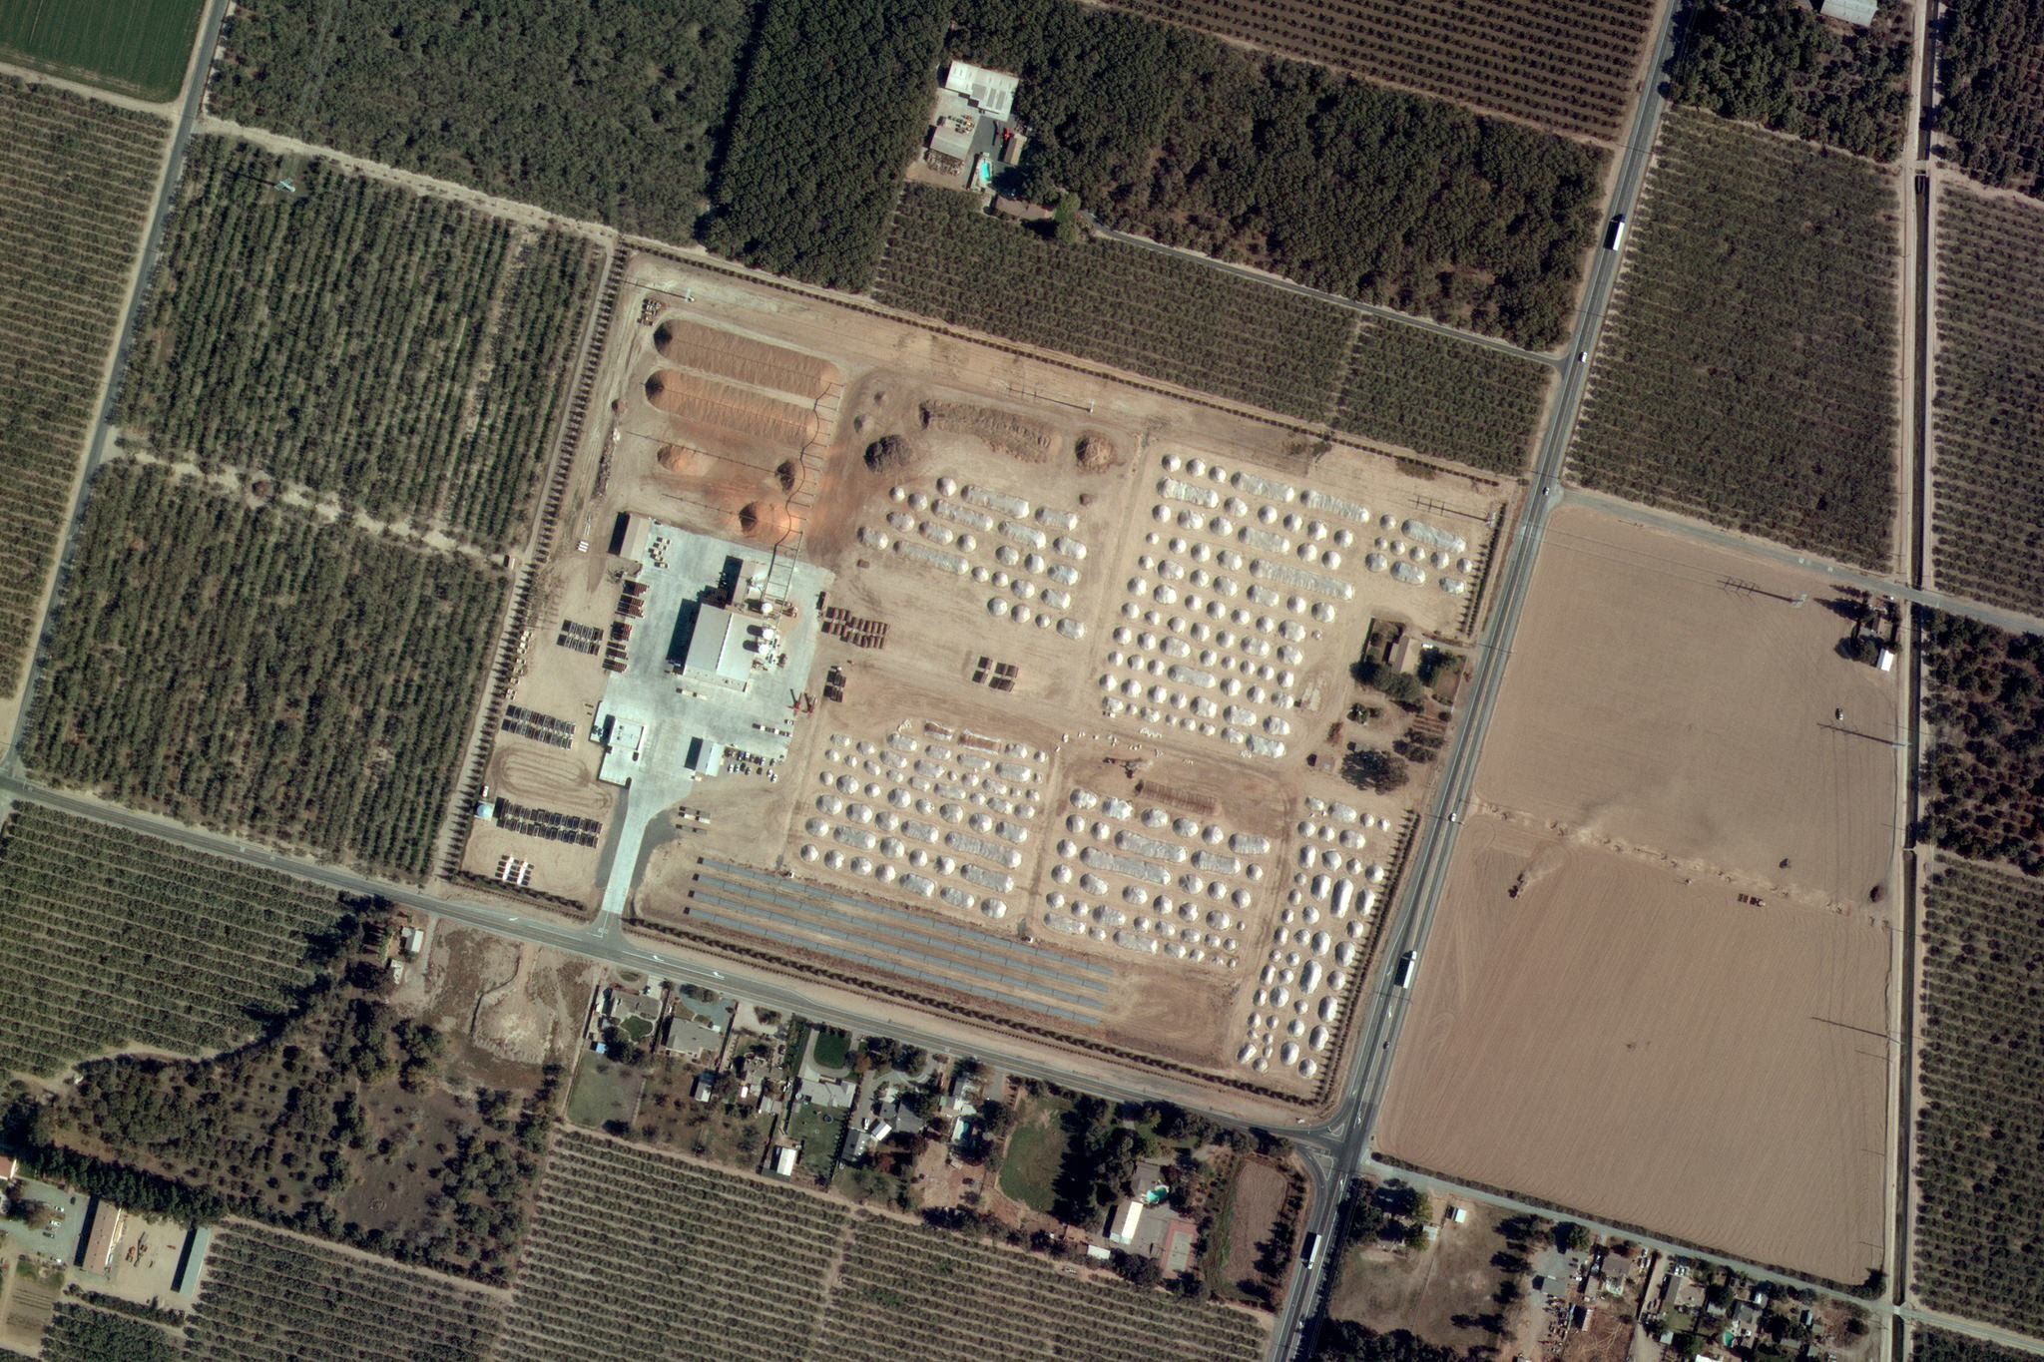
Farmers’ Pain:
Farms are multi-$M factories, where everything changes every week, and management can’t see it
Notes:
Farmers literally cannot see everything they have to manage. They spend a lot of management time and attention trying to figure out what’s happening in their fields. This, of course, translates into higher production costs and lower crop value because of the time lost.
TerrAvion’s imagery helps farmers to control the time spent managing and inspecting and allows them to focus their time on making big decisions for their crop production.
Our data is also the foundation for other statistical and analytical products — we can easily adjust the stream of data allows us to build those products rapidly and ahead of anyone else.

Slide 6
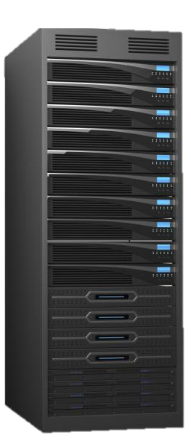
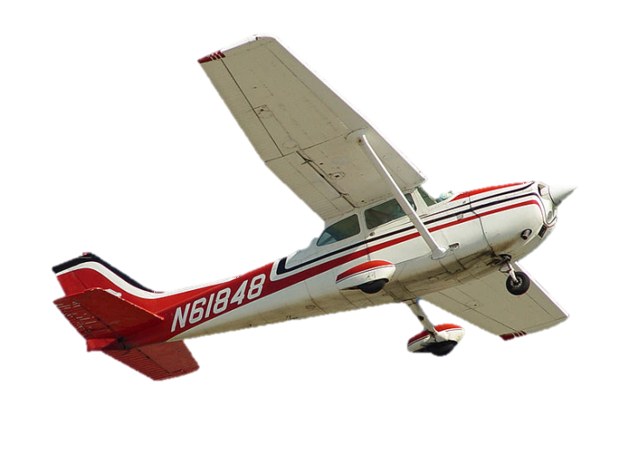
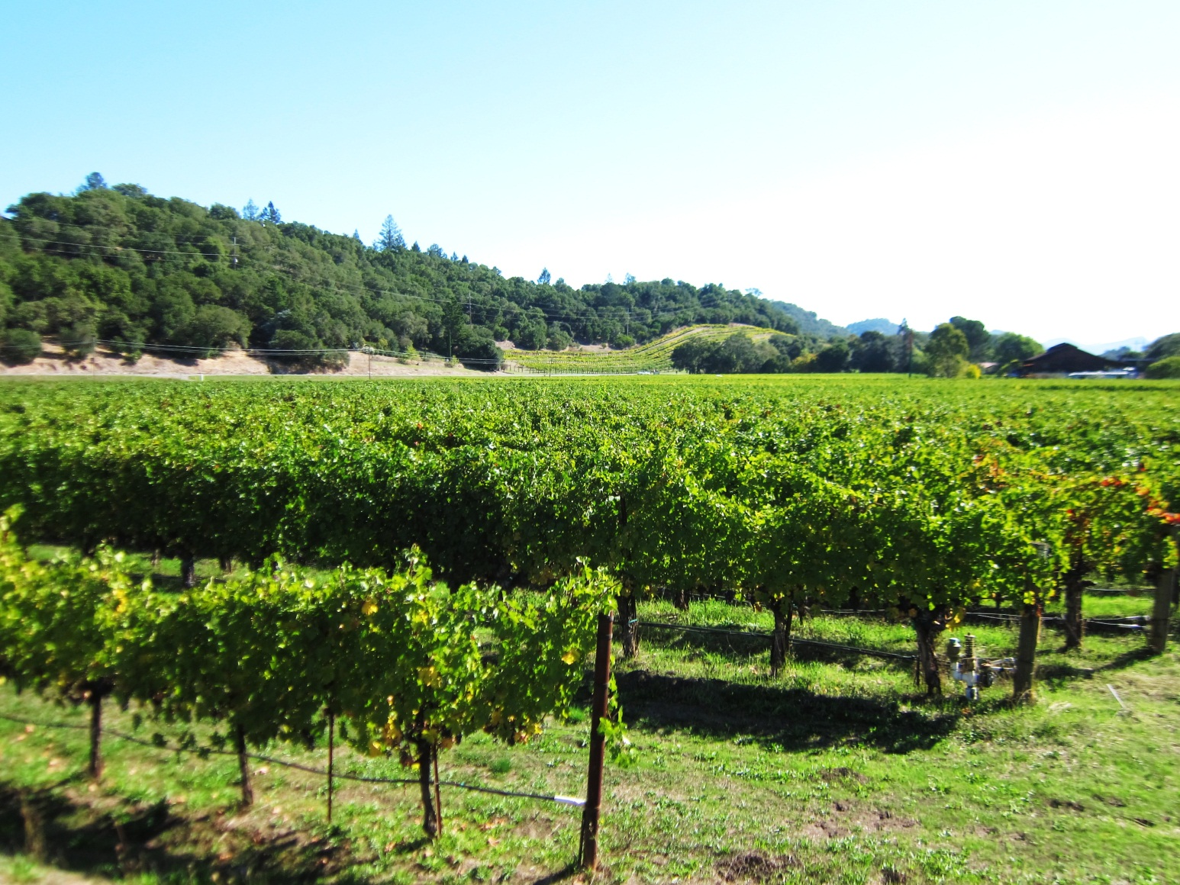
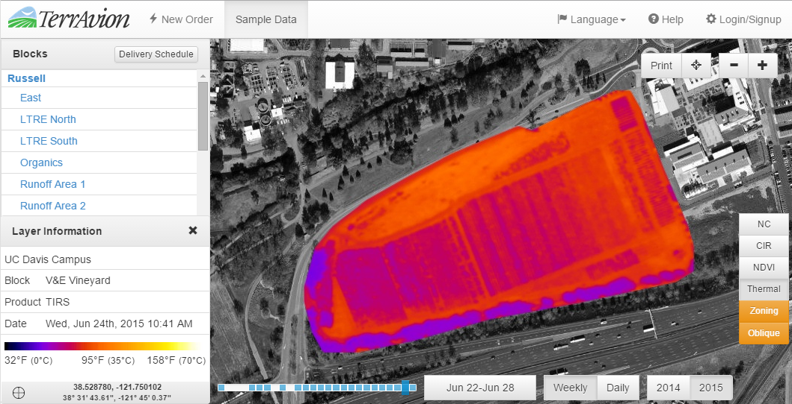
How TerrAvion OverView Works
The magic is the processing which allows the data to be delivered overnight for cheap
Covered acres scanned each operational cycle by contract aircraft
Custom integrated external sensor pod with COTS sensors
[Not to scale]
Output is delivered as a geo-referenced map and vegetative indices through web, iPad, and API
Notes:
This is our solution:
A manned aircraft flies over each subscriber during a collection cycle. We use subscriptions to aggregate demand, then we use proprietary image processing technology to cut our 90% of the work to deliver corrected imagery for use in farm operations through a web map.
It is the post processing and business model together which enable a bunch of other value changes and innovations such as low cost COTS sensors, API, direct to iPad delivery in the field, etc. These add up to an increasingly defensible solution with scale.
Also, despite the illustration, the aircraft fly high: 7,000-10,000’ (2000 meters to 3000 meters) above the ground, and fast, over 100 knots. (115 mph)

Slide 7
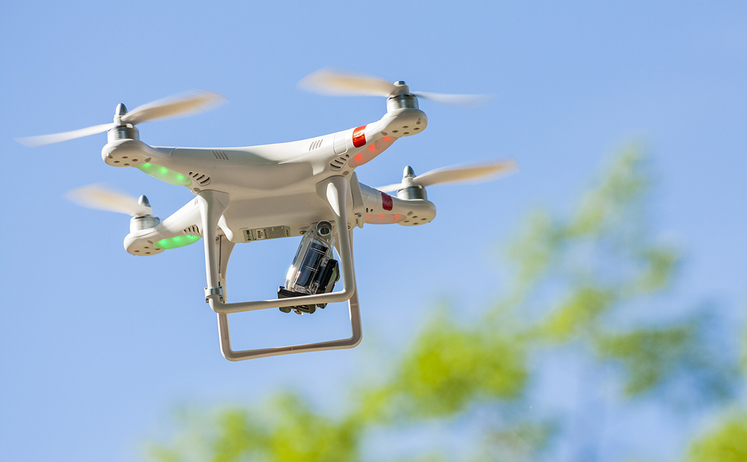
Why not drones?
Notes:
“Wait a minute”, you might be thinking. “TerrAvion doesn’t use drones?” We hear this question a lot. ☺
As cool as drones might be, TerrAvion doesn’t use drones to collect our imagery at the moment. Let’s talk a little bit about cost effectiveness.

Slide 8
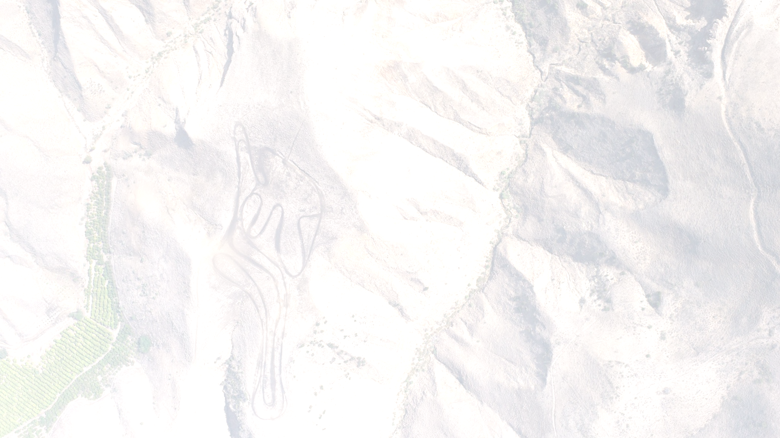
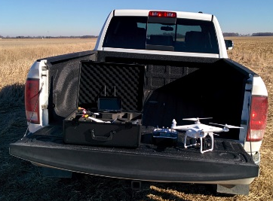
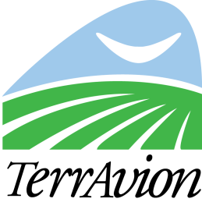
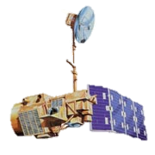
In mapping,
big, fast platforms reduce cost
High
Too Expensive
Good & Affordable
Electric Copters
Hand-Launched Fixed-Wing
Quality
(Responsiveness, Resolution, Speed, etc.)
Legacy
General Aviation
Not Good
Enough
Unaided Ground Scouting
Planned NanoSat Constellations
Commercial Satellite
Low
LANDSAT
Expensive
$1
Free
Single Pass Cost per Acre, Fully Delivered
Notes:
There is a tradeoff in imagery quality and cost. At one side of the tradeoff is Landsat, which is an earth observation satellite program, which gives data that cannot be used for operational management of farms, but the USGS gives it away for free if you’re up to the challenge of dealing with it. On the other side, electric drones give you an amazing amount of control over imagery, but they are the most expensive way (on a per acre, not per hour) basis to collect imagery.
TerrAvion uses technology to bump the efficient frontier out into a region where the data is good enough to be used at the individual plant level but is cost competitive with commercial satellite imagery solutions.

Slide 9

Dude + Drone + Truck = Expensive
Notes:
We already service 120 ranches in Sonoma County and we do that in one day with one pilot and do half of Napa in the afternoon—to send any sort of ground delivery around or build ground infrastructure is just orders of magnitude more expensive.
In other words, dudes and trucks aren’t getting cheaper.

Slide 10
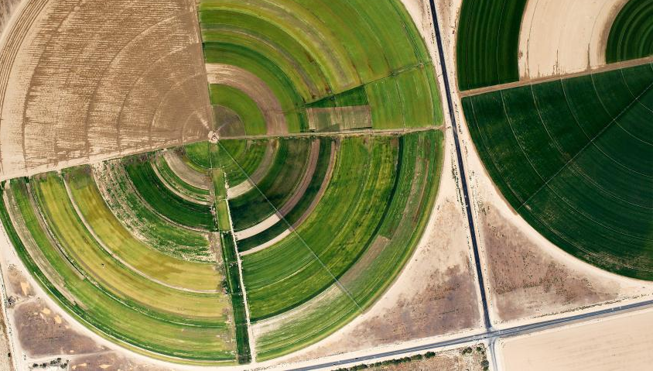
TerrAvion’s
Impact
10%
Increase
in Agricultural Productivity
We are doing this by answering,
“What do I have
to fix right now?”
Notes:
Our goal is to increase global agricultural output by 10% by making it possible for growers to see all their crops, whenever they might need to. In other words, we want to help farmers be able to pinpoint things in their fields that can turn into very costly problems later, as well as give them a bird’s eye view to know what’s going on.

Slide 11
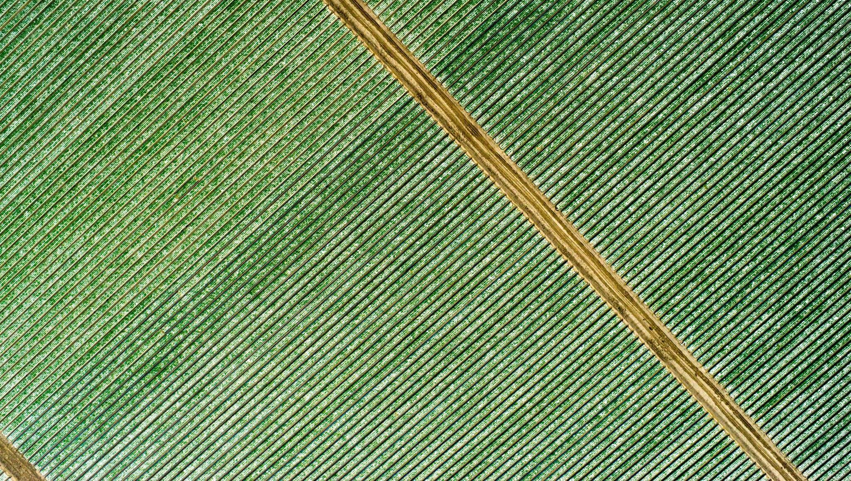
Notes:
So you might be wondering, “Ok, sounds like a solution, except… how can a farmer distinguish the condition of their crops if everything pretty much just looks green? How can they really tell?”

Slide 12
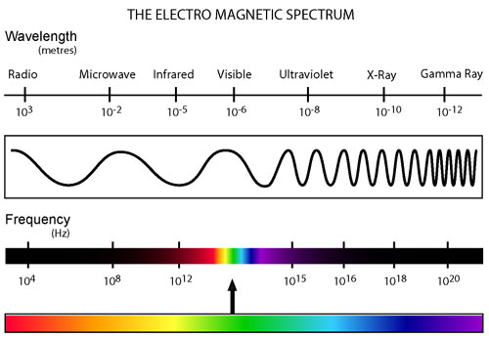
Physics Review: the Electromagnetic Spectrum
http://www.atmos.washington.edu/~hakim/301/electromagnetic-spectrum.jpg
Notes:
To answer that question, let’s do a quick physics review.
First of all, how many of you are familiar with the electromagnetic spectrum? (take a show of hands)
Here’s a graph that shows the electromagnetic spectrum. We’ll be focusing on the infrared and visible wavelengths.
The human eye is sensitive to the visible wavelengths, known as light. When those wavelengths are reflected off an object, the our eyes can see it. For example, if you see a red flower, that means that it is reflecting the “red” wavelengths, while absorbing the other wavelengths. That “red” that we see is associated with the color, red.

Slide 13
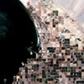
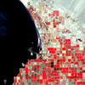
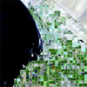
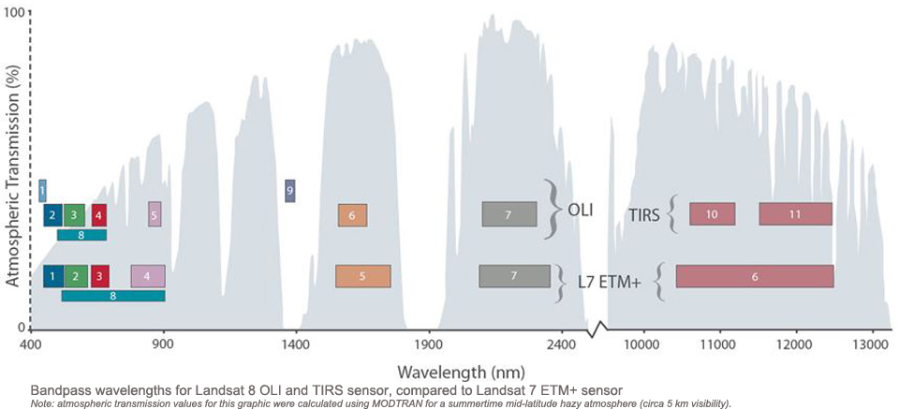
False color images
http://landsat.usgs.gov/L8_band_combos.php
Notes:
We use “false color” images, along with “natural color” images, to help our customers tell how their crops are doing. The natural color images are what you’d see with your own eyes – in other words, the blue, green, and red bands (ranges of wavelengths).
On the other hand, false color images usually also contain bands that are not visible, like infrared.
Here is a graph that shows the bands that earth observation satellites Landsat 8 and Landsat 7 capture. Landsat 8 is the upper colored row of numbers, and Landsat 7 is the lower row.
First is a “natural color” image – composed of bands 2, 3, and 4 (aka blue, green, and red). Next, a “color infrared” image – composed of green, red, and near-infrared (bands 3, 4, 5). Last is another false color image, composed of red and 2 different infrared bands (4, 6, and 7).
The pictures composed of these different bands are post-processed by computers, and the resulting image is assigned some different colors to help show the contrast between the different bands.
In a nutshell, that’s how the farmers will be able to distinguish the healthy vegetation from the unhealthy.
As you can see in the 2nd and 3rd images, the reds and greens show a high contrast, compared to the natural color, which help us to distinguish the healthy vegetation.

Slide 14
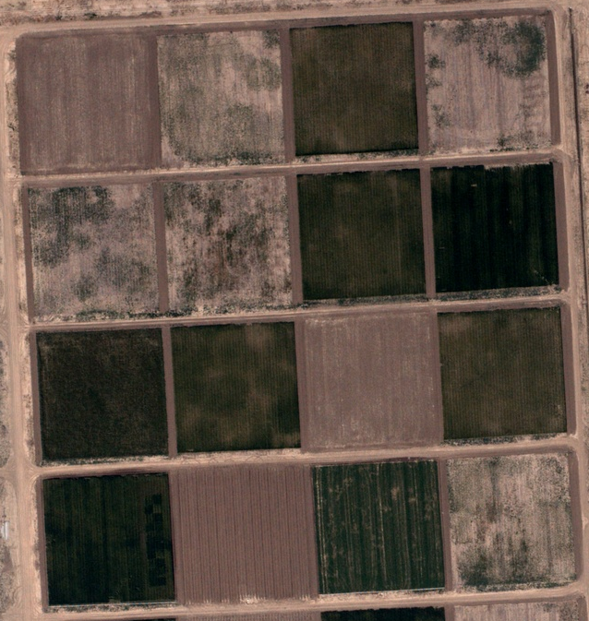
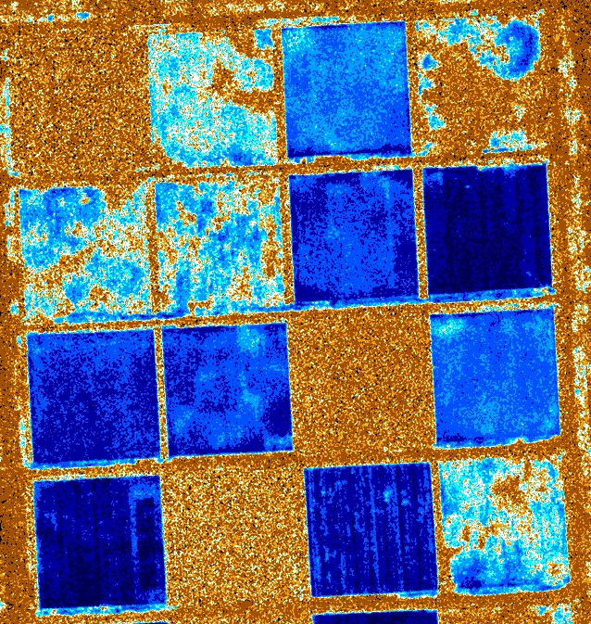
Example: Russell Ranch (UC Davis)
Natural Color
NDVI
Notes:
Here’s an example of Russell Ranch in UC Davis, in natural color. These are a few different crops, which look pretty much the same from a bird’s eye view. Well, sort of. Can you tell which crops look healthy, and which do not? I can definitely tell that the brown plots are probably just dirt, but everything else is a little more tricky.
Now let’s look at an NDVI image of the same plots of land. NDVI stands for “normalized difference vegetation index”, which is an indicator that helps assess if there is healthy vegetation. This NDVI image indicates to us that the deeper blue parts are more healthy vegetation, while the brown areas are dirt.
Let’s do a few case studies now.

Slide 15
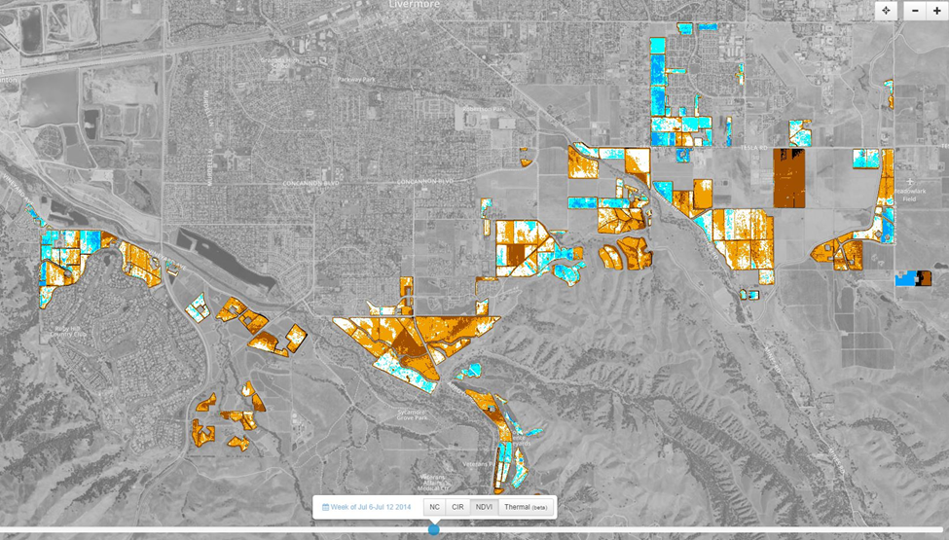
Where do you send
your assistant managers?
Notes:
This view is of a TerrAvion customer whose ranches are spread out over 80+ miles, but even in this sub-section it is easy to see why an up to date map of the area would help decide where the grower and his managers need to spend their time. They know what should be blue (high vigor, or chlorophyll content) and what should be orange (low vigor).

Slide 16
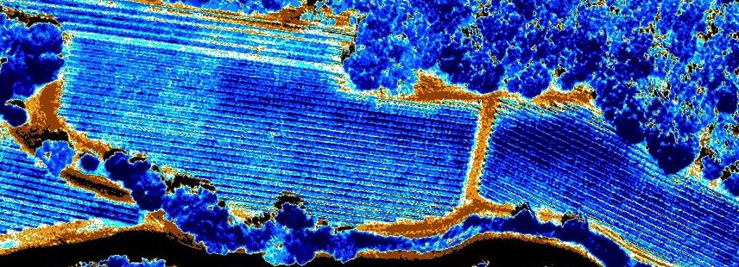
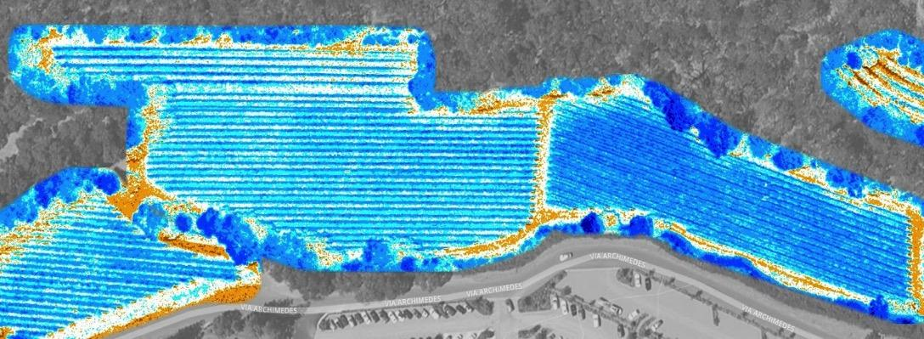
2
1
What should get harvested together?
2013
2
1
2014
Notes:
Here we have 2 blocks where some of the crop was ripening faster in some areas. TerrAvion imagery helped this grower to identify the circled area of block 2 first, in 2013, which the grower harvested at the same time as block 1.
In 2014, the grower was able to harvest all of block 1 together, and then all of block 2. This is definitely a lot more of a straightforward approach.
Basically, the goal here is to help the grower maintain uniformity in the vegetation, which then helps during harvest, so that the workers don’t have to spend time trying to decide how much to harvest.

Slide 17
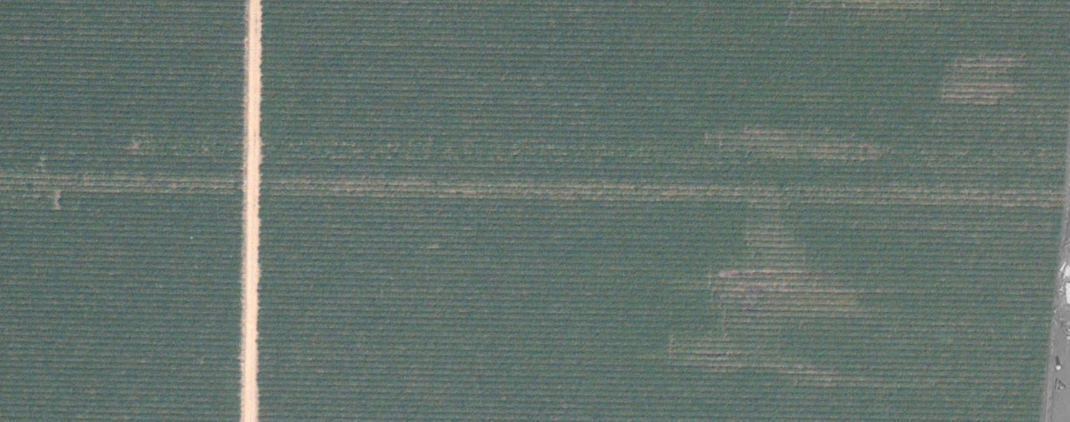
Where do you
check for pests?
Notes:
One important part of crop management is scouting. Farmers scout their fields for things like irrigation problems, cultural practices, diseases, etc.
This is an 80-acre field. Going through all the rows of the field would be very time consuming without aerial imagery. By using the imagery, farmers can focus their attention on patchy or less vigorous areas like in this example.

Slide 18
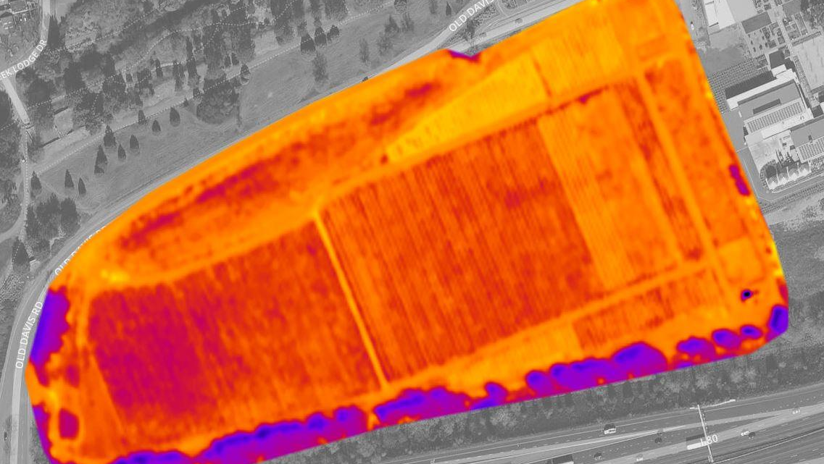
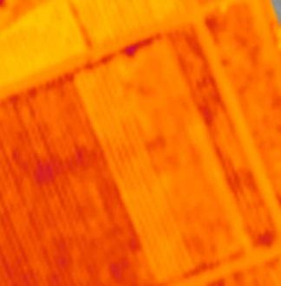
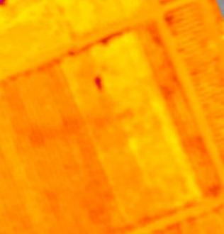
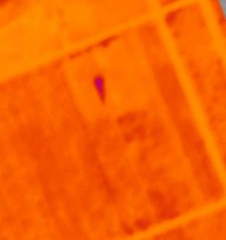
Where do you
check for irrigation leaks?
Week A
Week B
Week C
Notes:
Here is a thermal view of another field over the course of 3 weeks. The darker purple areas are cooler in temperature, and the brighter orange and yellows are warmer. As you compare Week A to Week B and C, you’ll see that there is a growing dot in the top 3rd of the boxed area. It turned out that this was an irrigation leak. Over the 3 weeks, that area basically became a mud puddle, which explains the temperature drop (and thus a growing purple dot).

Slide 19
Working at TerrAvion
Agriculture
Viticulture
Mathematics
Aviation
Remote Sensing
GIS (geographic information systems)
Web Development
Sensor Calibration
Optics and Imaging
Image Processing/ Computer Vision
Machine Learning
Systems Engineering
Mechanical Engineering
Notes:
Now that you know what TerrAvion does and why, let’s talk about what it’s like working at TerrAvion.
If you were to spend a week in the TerrAvion office, what kind of disciplines and skillsets would you be able to observe?
This isn’t an exhaustive list, but here’s a good mix:
Agriculture
Viticulture
Mathematics
Aviation
Remote sensing
GIS (geographic information systems)
Web development
Sensor calibration
Optics and Imaging
Image processing/Computer Vision
Machine learning
Systems engineering
Mechanical engineering (designing and building our equipment)
A lot of you are pretty familiar with these specialties. While everyone at TerrAvion has at least one area of expertise, we all have some understanding of the other specialties. For example, just from working at TerrAvion, I’ve learned a lot about Remote Sensing and GIS.

Slide 20
GIS (Geographic Information System)
Visualize and analyze data
Tools:
Google Earth
ArcGIS
QGIS
Cholera outbreak GIS example: http://cariseterravion.github.io/nylf-2015/
Notes:
What is GIS? It involves the analysis of data according to their location, usually on a map. This is useful for many different applications. In the case of TerrAvion, we use it for agriculture. Other examples of application include (but are not limited to) business (like marketing), public health, science, disaster response, and crime trends.
In GIS, there are a few common programs that people use:
Google Earth
ArcGIS – a very expensive, but powerful piece of software
QGIS – an open source software
I have one example of how to use Google Earth with a popular GIS case study. There was a cholera outbreak in Soho, London. A physician named John Snow took the locations of where people had died (there were about 120 of them) and plotted those locations on a map. He found that those deaths were near a water pump in Broad Street and suggested that it be shut down. This led to the hypothesis that cholera was spread by drinking contaminated water.
You can download Google Earth Pro for free now. I have instructions on the link provided on how to import the cholera deaths data.
(If I have time, I will show the students a demonstration of Google Earth Pro and the Cholera kml file)

Slide 21
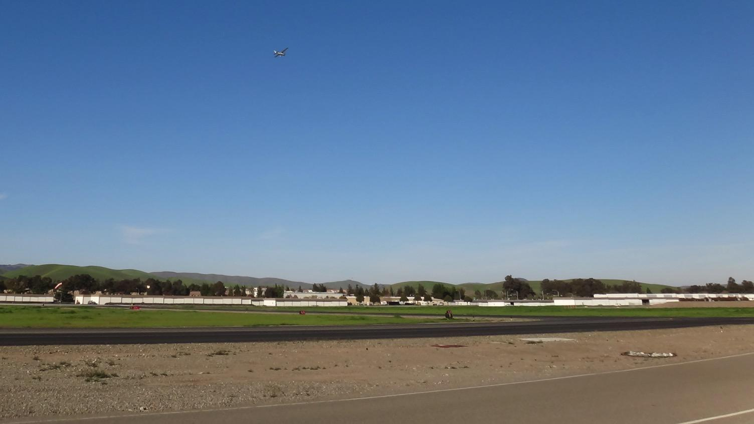

QUESTIONS?
Carise Fernandez
carise@terravion.com
Software Engineer, TerrAvion
Notes:
Thank you for your participation in today’s seminar. I hope the information was helpful in some way.
Depending on the amount of time I have left, I should ask if the students have any questions.
If you’d like to keep in touch, you may contact me at my email address.

Slide 22
References
“Does the world produce enough food to feed everyone?” http://www.worldhunger.org/articles/Learn/world%20hunger%20facts%202002.htm
“Farmers List Top Issues Impacting Agriculture” http://westernfarmpress.com/management/farmers-list-top-issues-impacting-agriculture
“What is Sustainable Agriculture?” http://www.sarep.ucdavis.edu/about-sarep/def
“What is Multispectral Imaging?” http://www.spectralcameras.com/spectralcamerasupport
“Frequently Asked Questions about the Landsat Missions” http://landsat.usgs.gov/band_designations_landsat_satellites.php, http://landsat.usgs.gov/L8_band_combos.php
“Light Absorption, Reflection, and Transmission” http://www.physicsclassroom.com/class/light/Lesson-2/Light-Absorption,-Reflection,-and-Transmission
“John Snow’s Cholera Map Using GIS Data” http://www.gislounge.com/john-snows-cholera-map-gis-data/

